Slide 1
Data Structures and Algorithms
BSc. In Computing
Semester 5 Lecture 7
Lecturer:Arnie Hensman

Slide 2

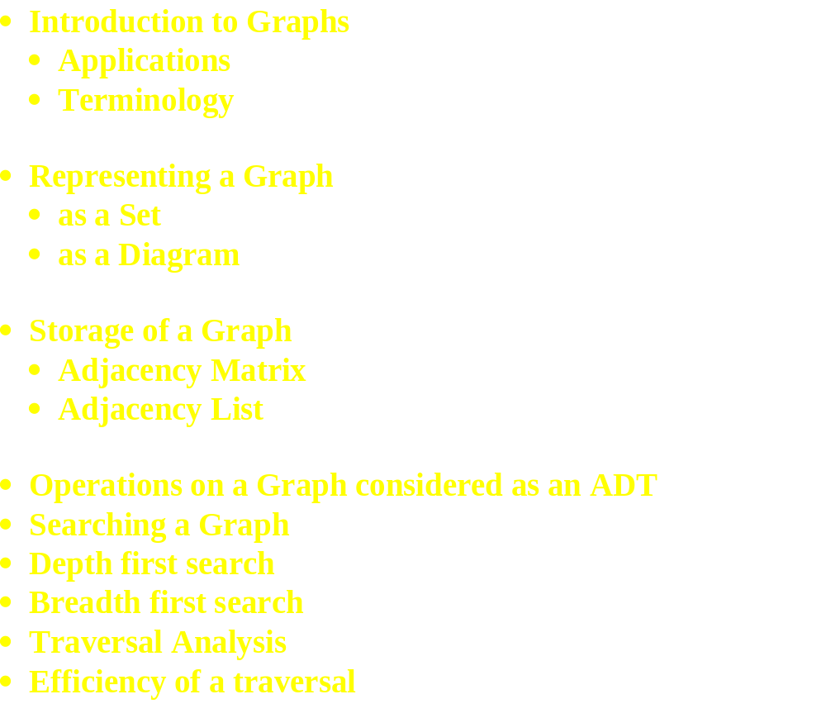
This Week:

Slide 3
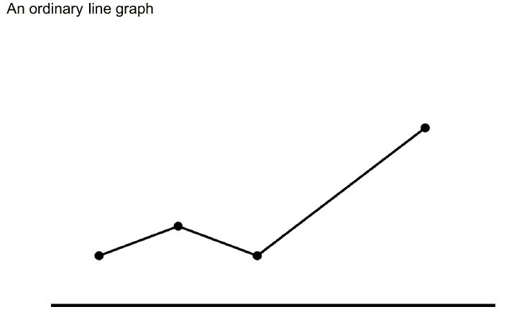

Slide 4
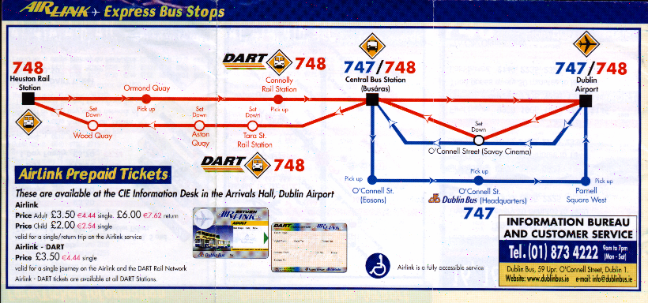

Slide 5
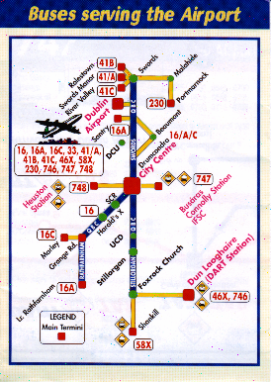

Slide 6
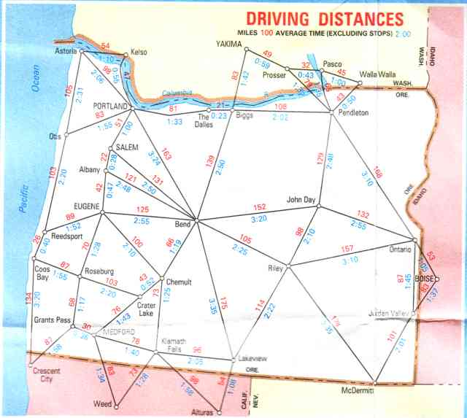

Slide 7
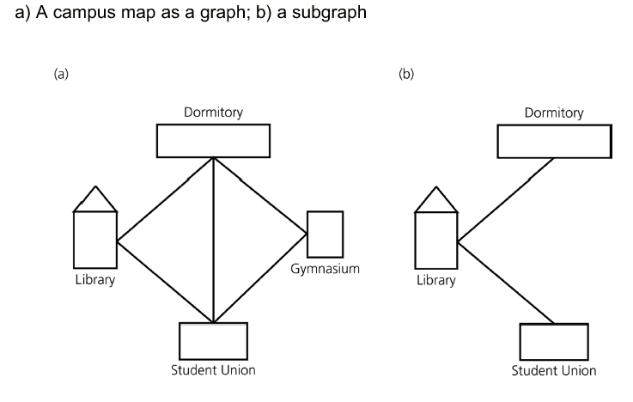

Slide 8
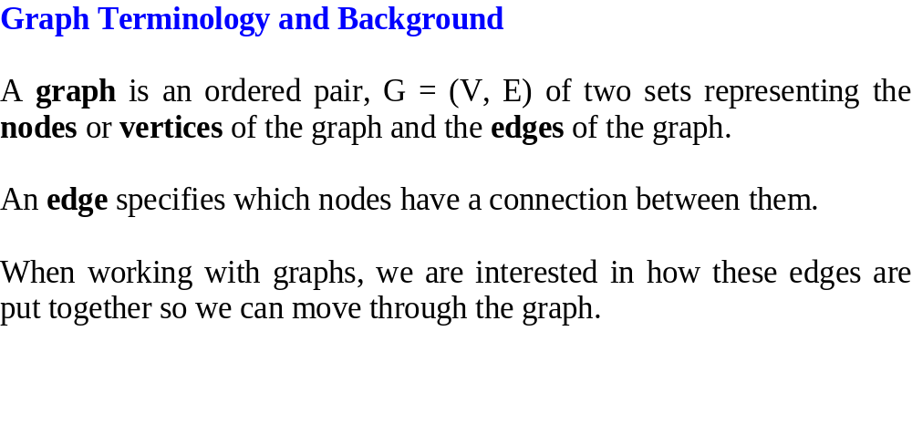
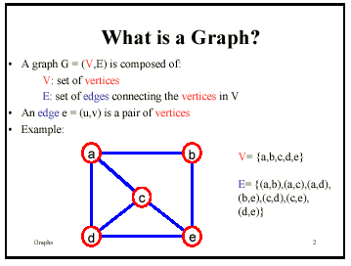

Slide 9
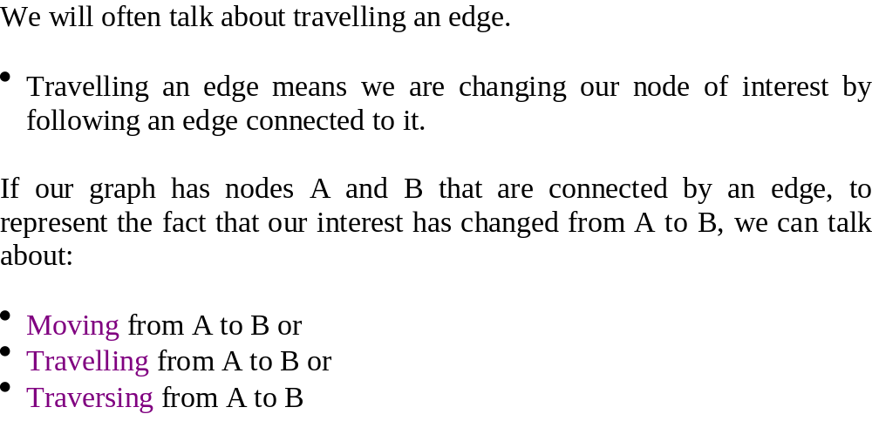

Slide 10
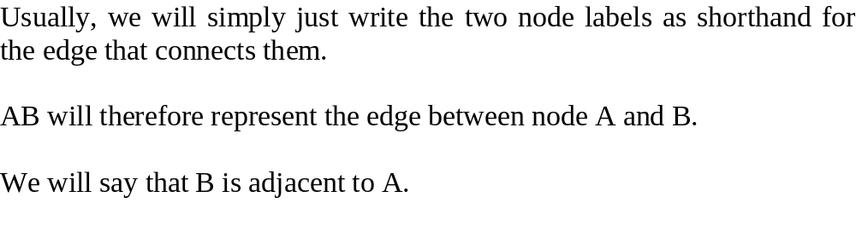

Slide 11
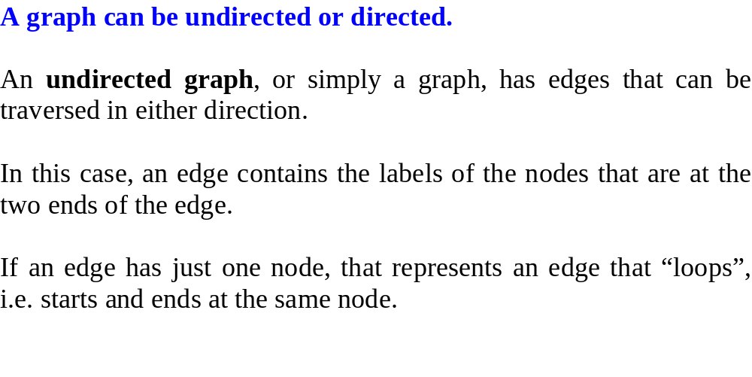

Slide 12
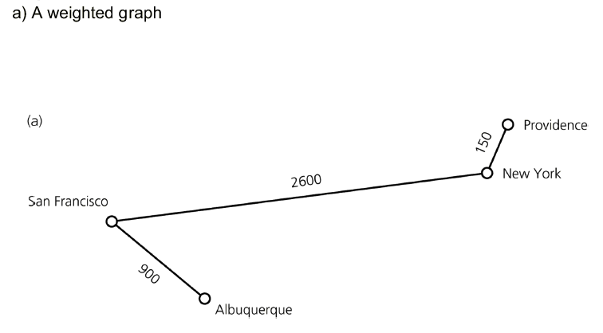
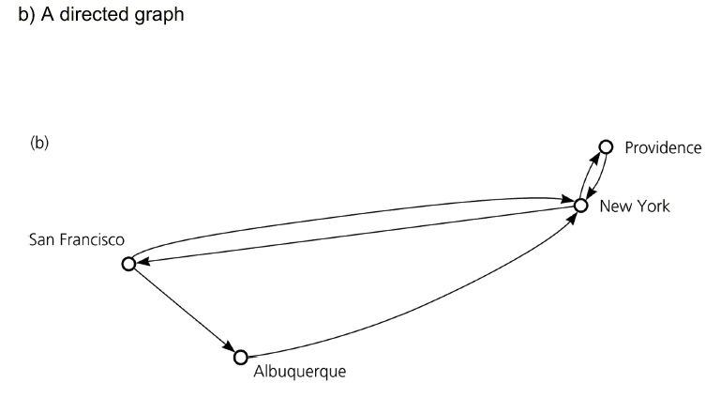

Slide 13
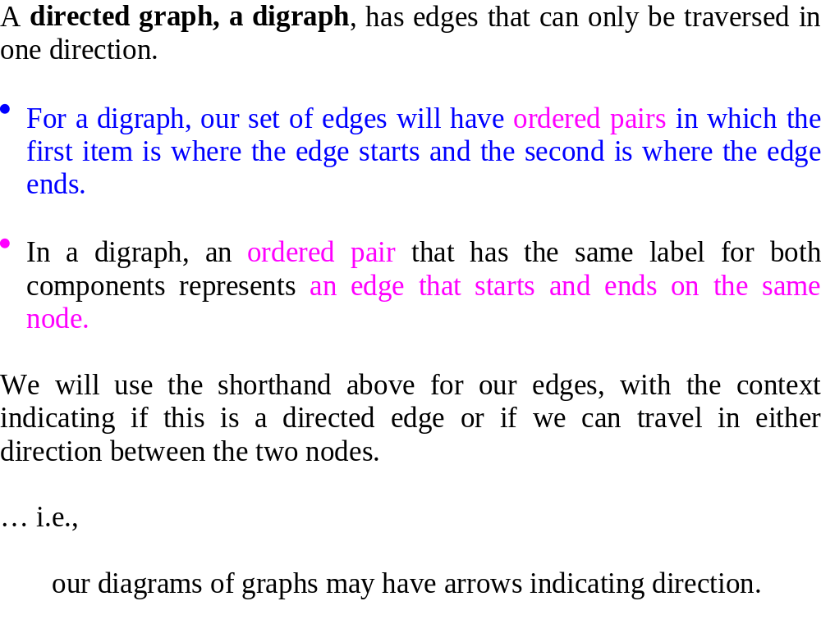

Slide 14
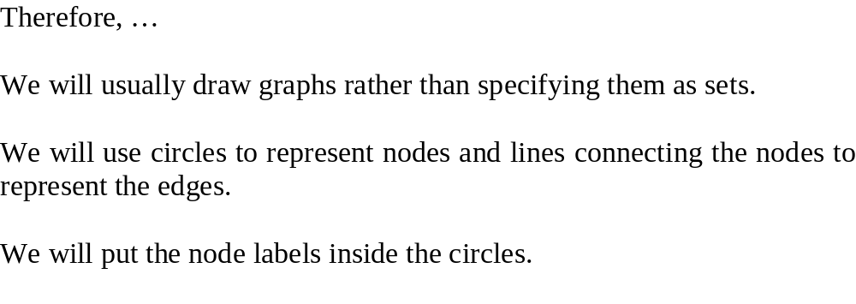

Slide 15
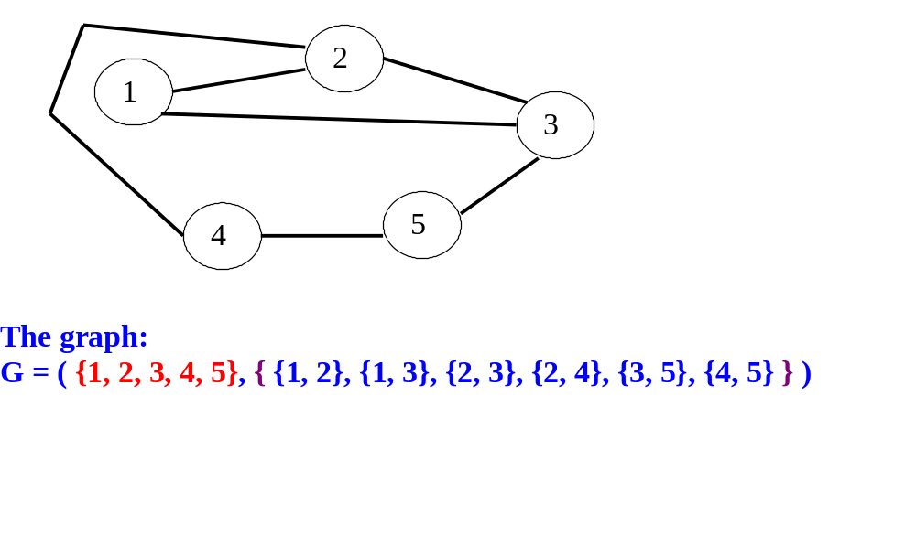

Slide 16
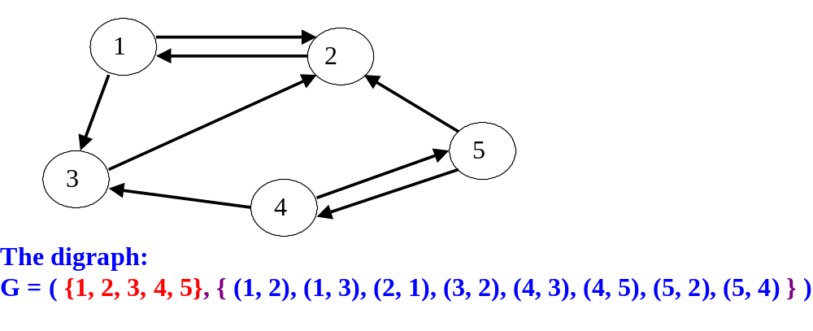

Slide 17
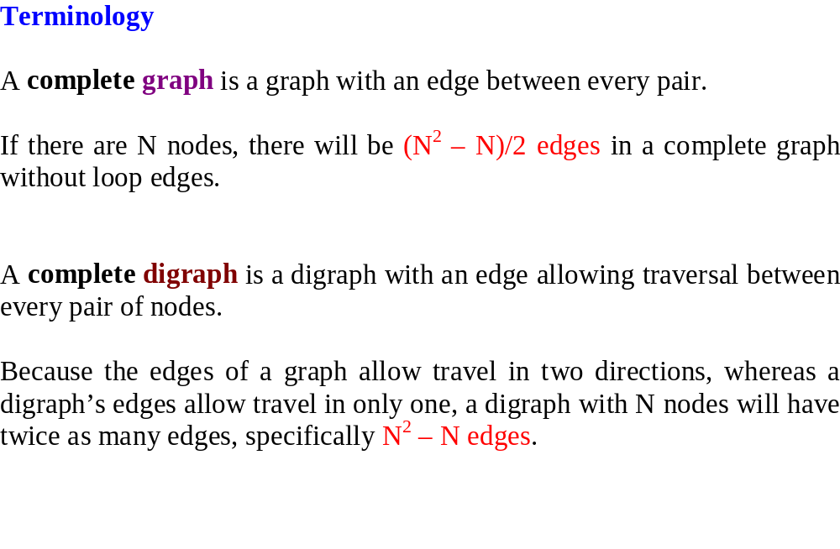

Slide 18
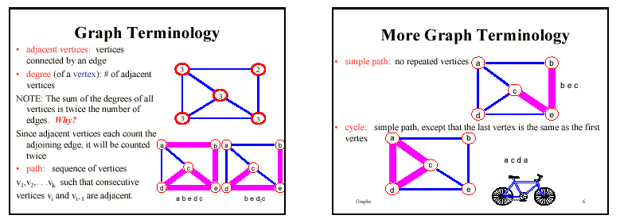
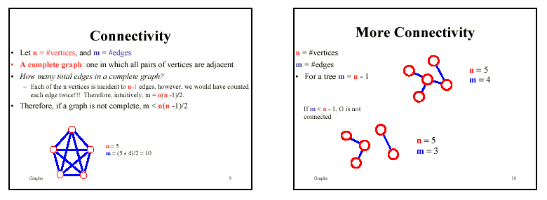

Slide 19
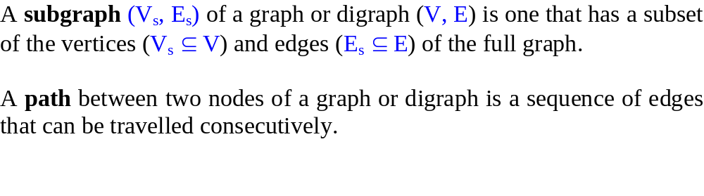
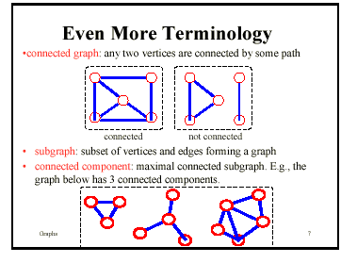

Slide 20
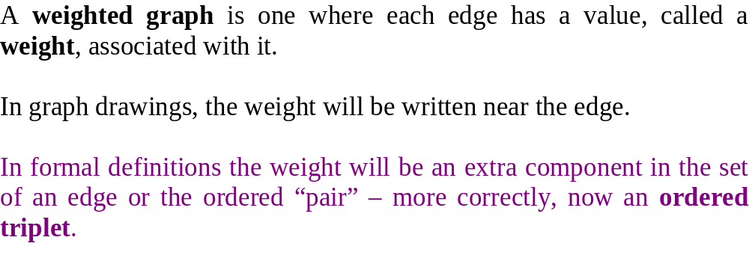

Slide 21
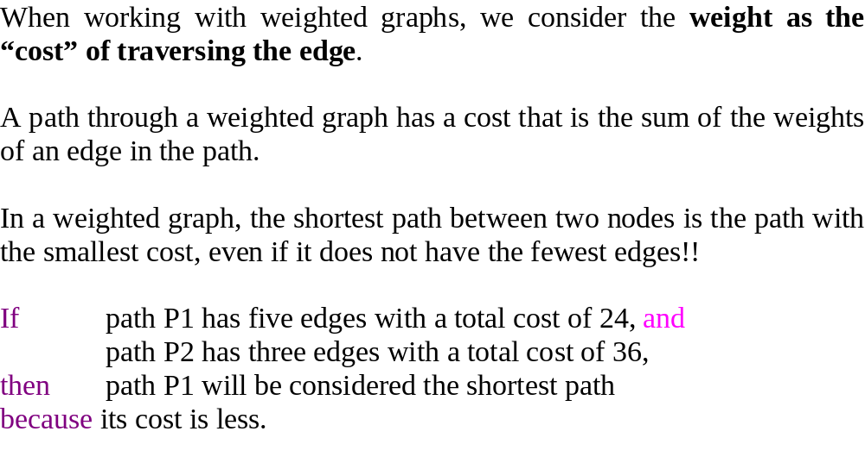

Slide 22
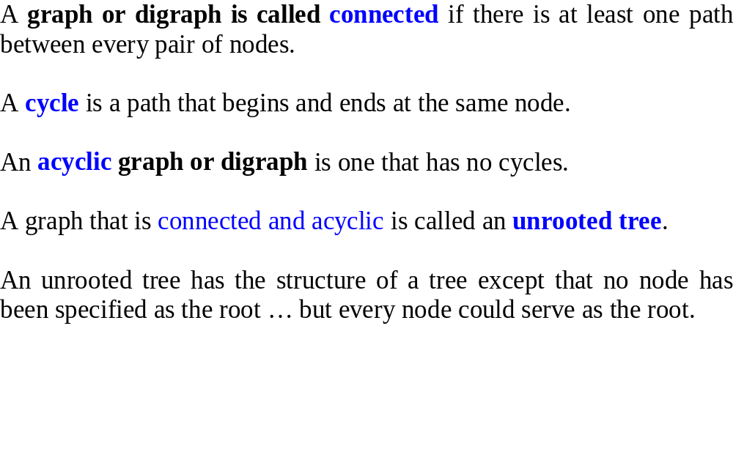

Slide 23
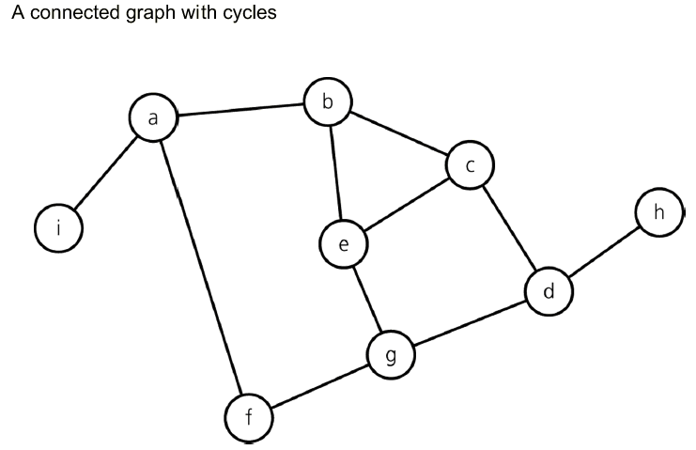
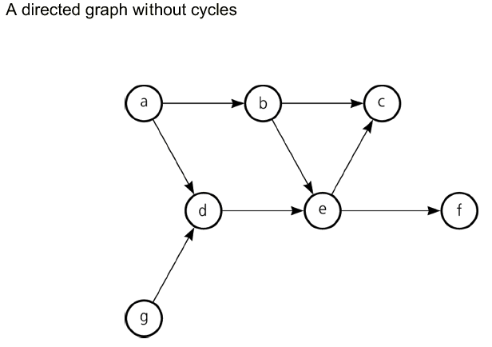

Slide 24
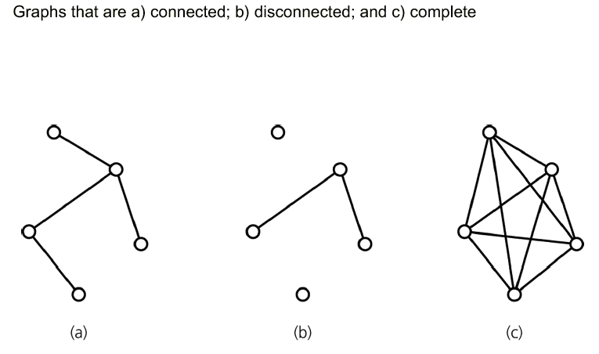

Slide 25
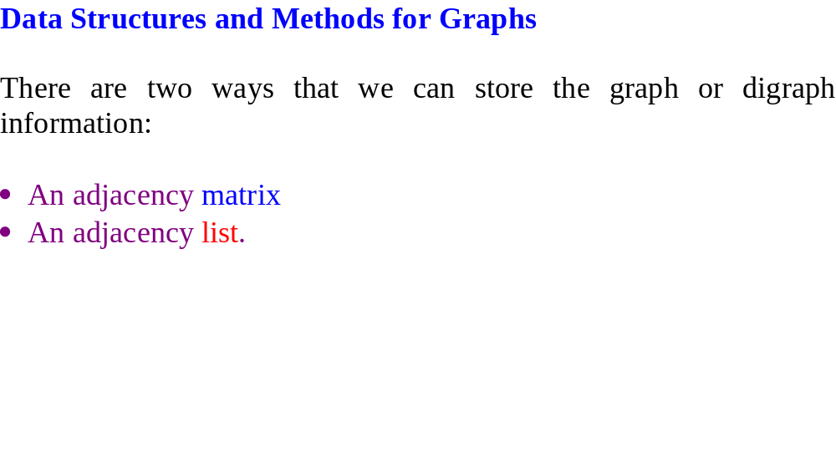

Slide 26
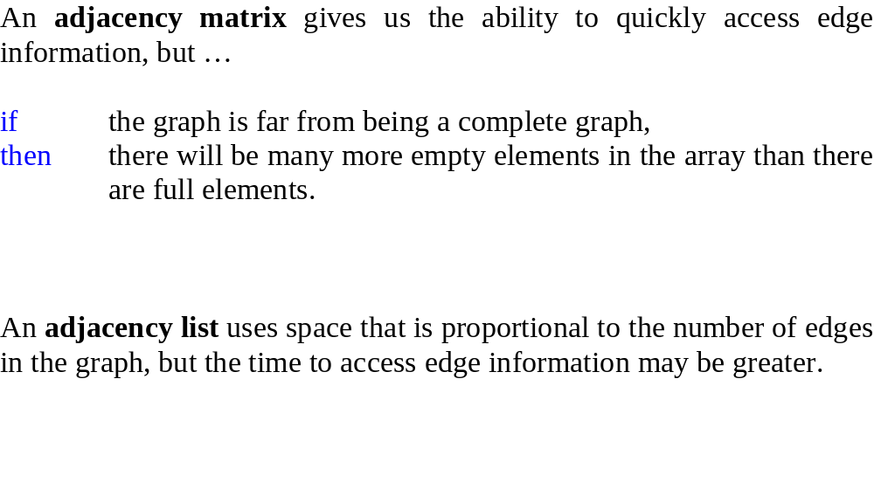

Slide 27
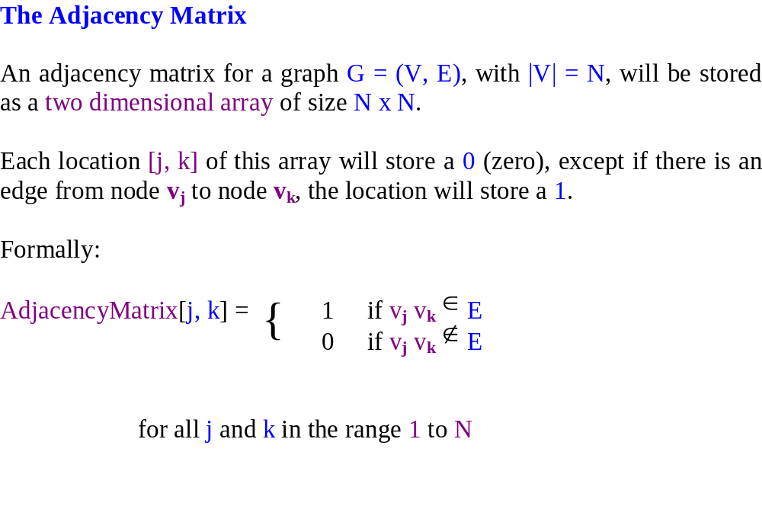

Slide 28
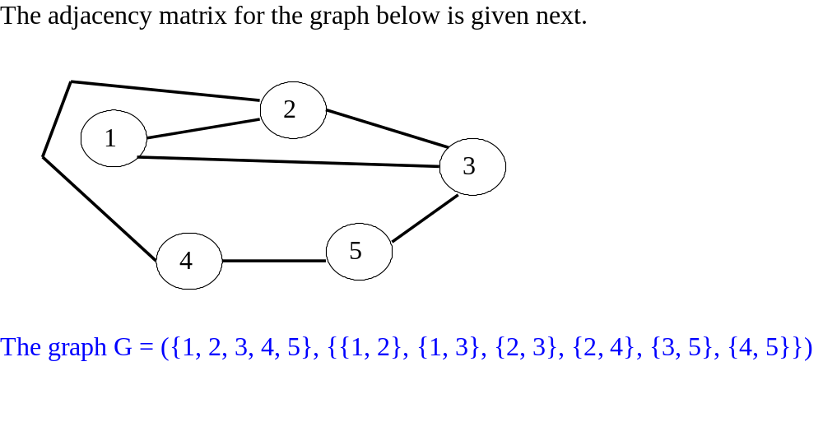
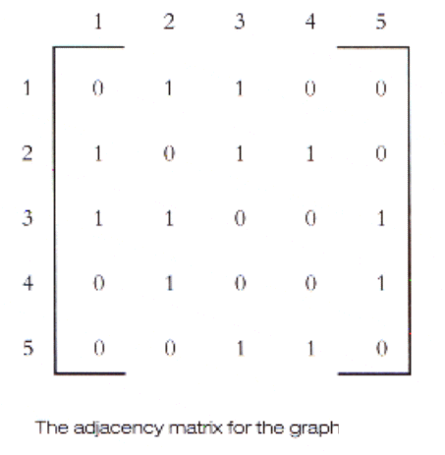

Slide 30
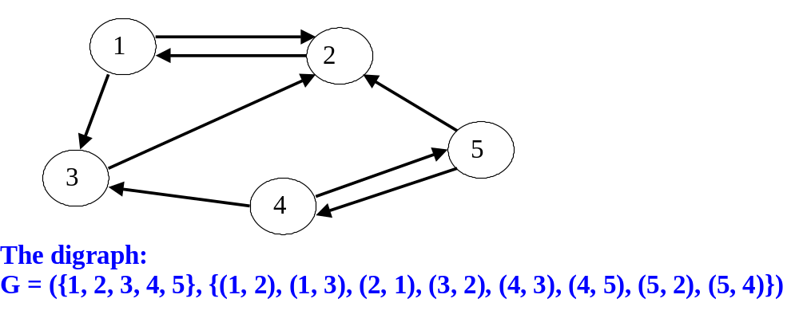
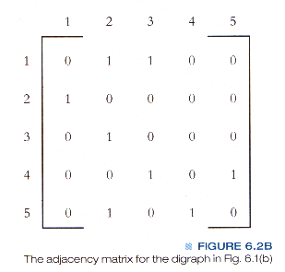

Slide 32
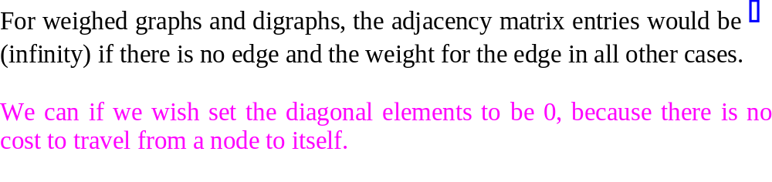
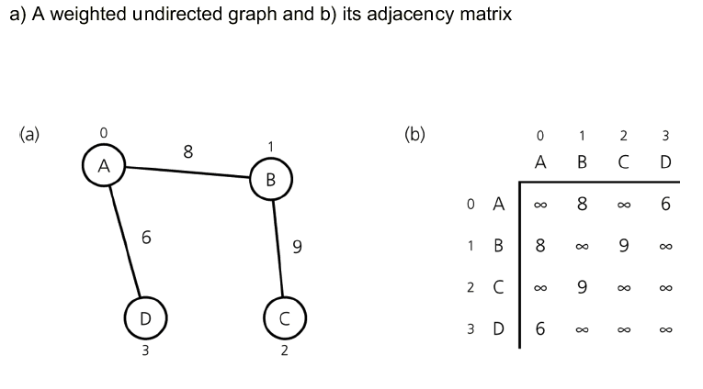

Slide 33
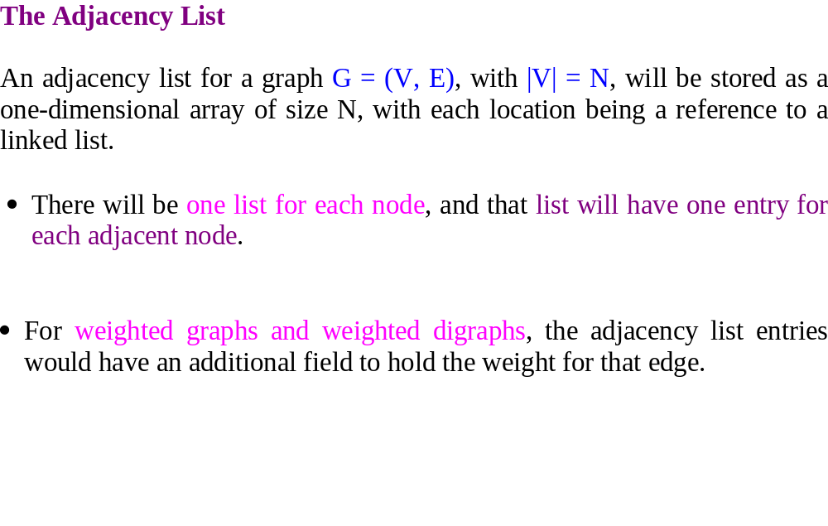

Slide 34
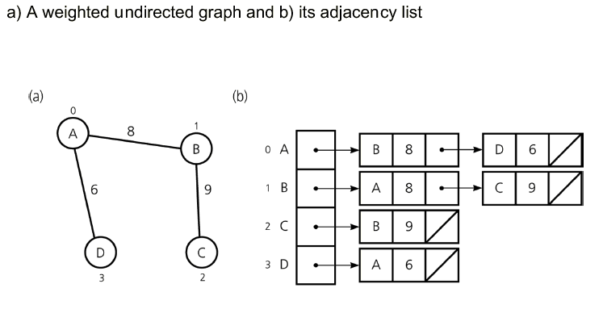

Slide 35
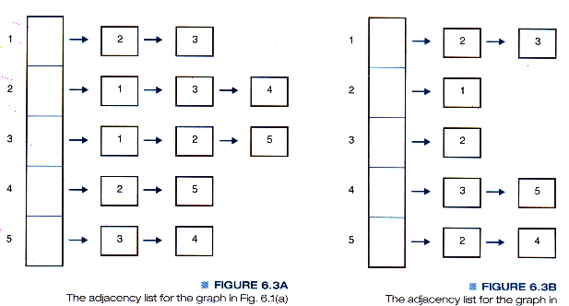
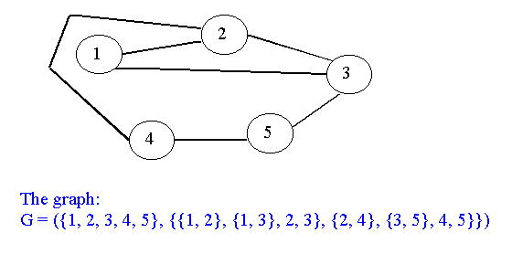
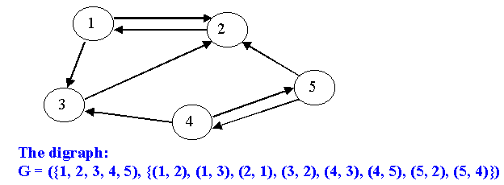
{ {

Slide 36
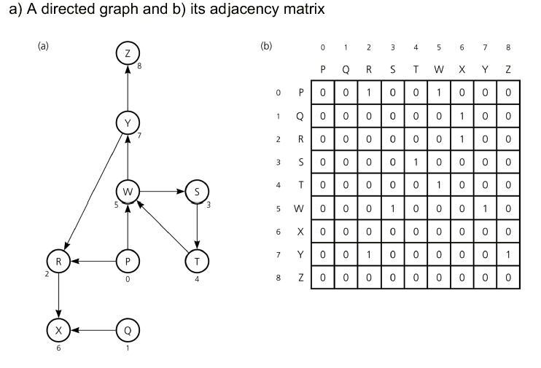

Slide 37
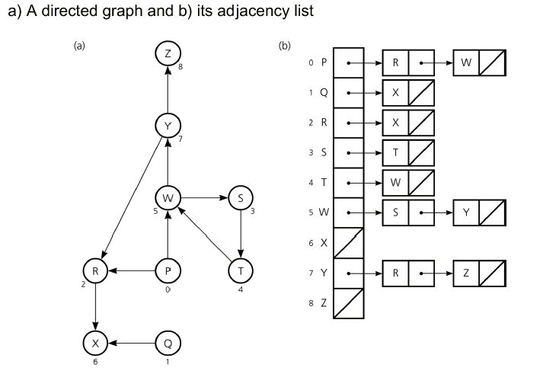

Slide 38
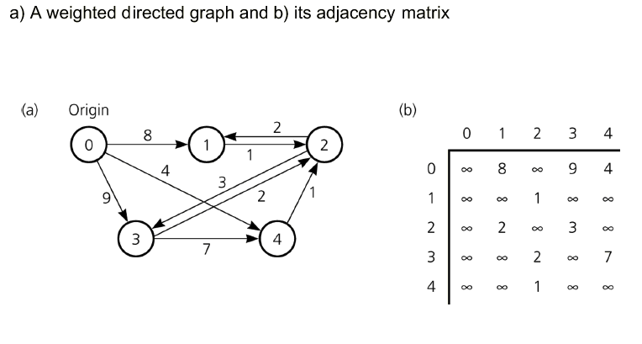

Slide 39
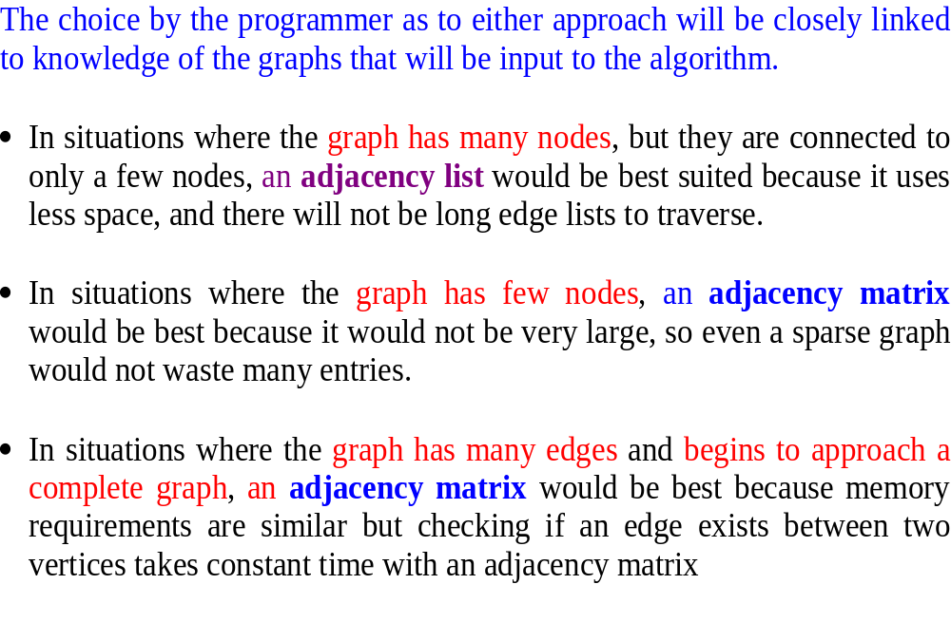

Slide 40
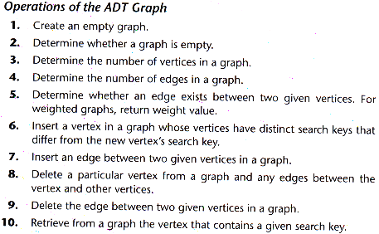

Slide 41
Programs to do this week:

Slide 42
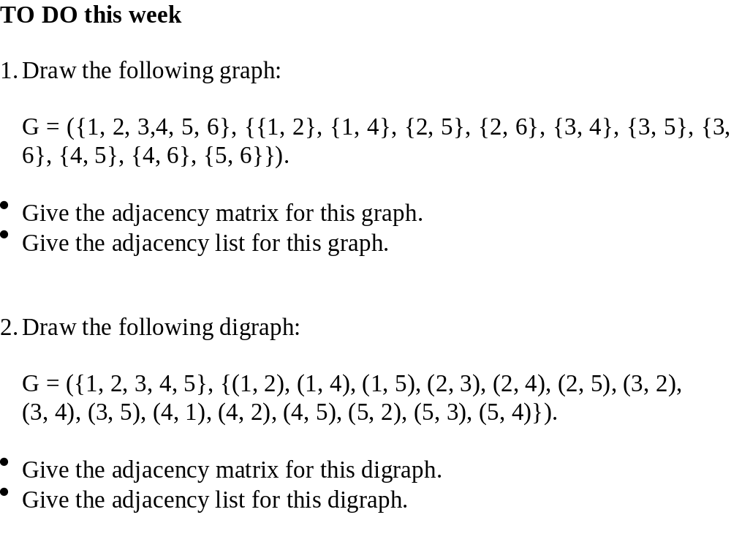

Slide 43
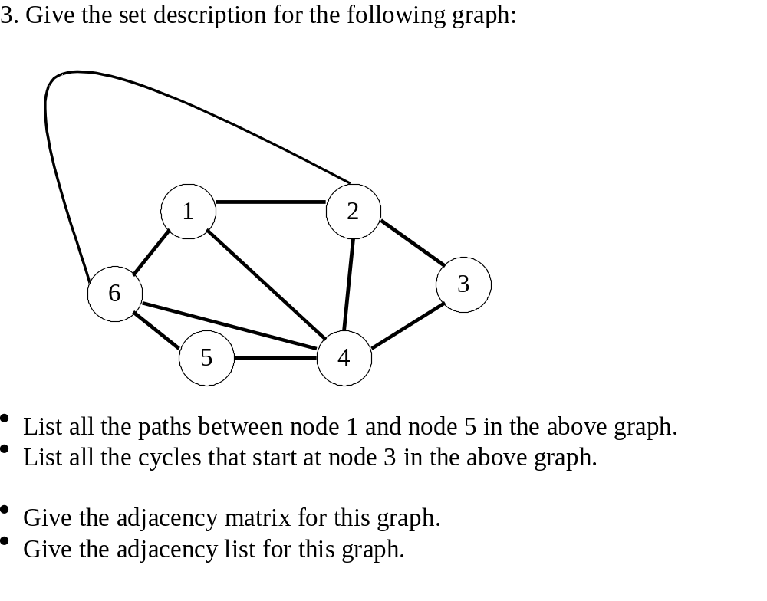

Slide 44
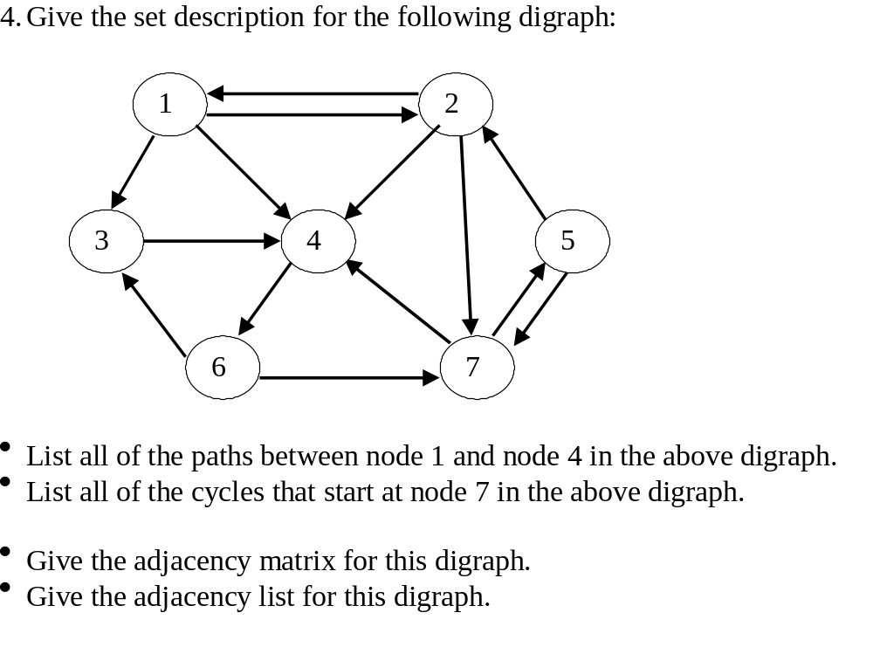

Slide 45


Slide 46


Slide 47


Slide 48


Slide 49

1
2
3
5
9
7
8
6
4

Slide 50


1
2
3
5
9
7
8
6
4

Slide 51


Slide 52

1
2
3
5
9
7
8
6
4

Slide 53


5
1
2
3
9
7
8
6
4

Slide 54


Slide 55


Slide 56


Slide 57


Slide 58



Slide 59


Slide 60



Slide 61
Programs to do this week:

Slide 62

1. For the following graphs, give the order that the nodes will be first visited
when doing a breadth-first traversal starting at the node labelled with a 1.

Slide 63
2. For the following graphs, give the order that the nodes will be first visited when doing a depth-first traversal starting at the node labelled with a 1.

Slide 64
3. You are required to verify your DF Traversal answer for graph (a) (back one slide) by implementing the recursive DFS algorithm in a Java application/applet.
Use an adjacency matrix to represent the graph, but include an extra column in the graph to keep track of which nodes have been visited.
You must use a recursive function that performs a Depth First traversal of the graph and shows the order of this traversal by printing out the current node or vertex (See pseudo code overleaf)
Create a graph class that has methods to add an edge between two nodes and also to do a DF traversal of the graph
You should also create a test class that creates a graph object, adds the required edges and invokes it’s traversal method

Slide 65
Print(v);

